Slide 1
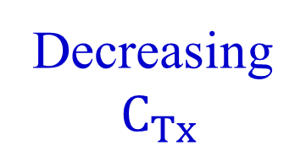

Normalized gain
Increasing
$C_{Tx}$
Designed
system
Decreasing
$C_{Tx}$
Normalized frequency

